Slide 1
Federated Identity & Attribute Based Resource Access Controls
By Kingsley Idehen
Founder & CEO, OpenLink Software

Slide 2
SITUATION ANALYSIS

Slide 3
Presentation Goals
Deconstruct:
Identity
Identifiers
Identification

Slide 4
Identity
EVERY DAY WE HEAR
IDENTITY IS PROBLEMATIC
IDENTITY IS COMPLEX
IDENTITY IS IMPORTANT

Slide 5
Identity
WE ALMOST NEVER HEAR ABOUT
WHAT IDENTITY ACTUALLY IS
HOW IDENTITY IS CREATED
HOW IDENTITY IS REPRESENTED

Slide 6
Identity Basics

Slide 7
What is an Entity?
An Entity is a Distinctly Identifiable Thing

Slide 8
How is an Entity Identified (Named) ?
An Entity is Identified (or named) through the combined effects of Identifier based denotation (signification) and document content based connotation (description).

Slide 9
How is an Entity Denoted?
An Entity is Denoted (Signified) through the use of an Identifier.

Slide 10
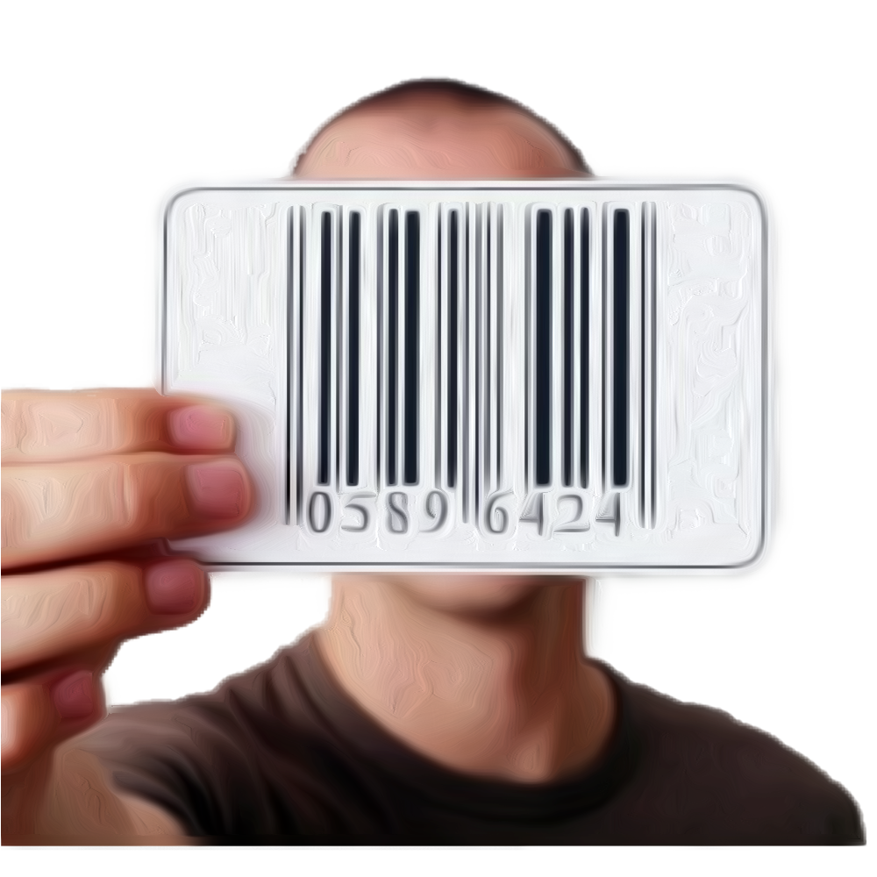
What is an Identifier?
An Identifier is a Sign (or Token) that Signifies (Denotes, or
“Stands For”) an Entity

Slide 11
Identifier Types?
Quoted Literals such as:
“Kingsley Idehen” or ‘Kingsley Idehen’
Relative Reference:
<#KingsleyIdehen>
Absolute HTTP URI based Reference:
<http://kingsley.idehen.net/dataspace/person/kidehen#this>
LDAP URI based Reference:
<ldap://mail.openlinksw.com/cn=Kingsley%20Idehen%2Cou=Accounts%2Co=OpenLink%20Software%2Cc=US>

Slide 12
What is a WebID?
An HTTP Uniform Resource Identifier (URI) that identifies (names) an Agent.
Example:
<http://kingsley.idehen.net/dataspace/person/kidehen#this>

Slide 13
What is a NetID?
A Resolvable Uniform Resource Identifier (URI) that identifies (names) an Agent.
Example:
<ldap://mail.openlinksw.com/cn=Kingsley%20Idehen%2Cou=Accounts%2Co=OpenLink%20Software%2Cc=US>

Slide 14
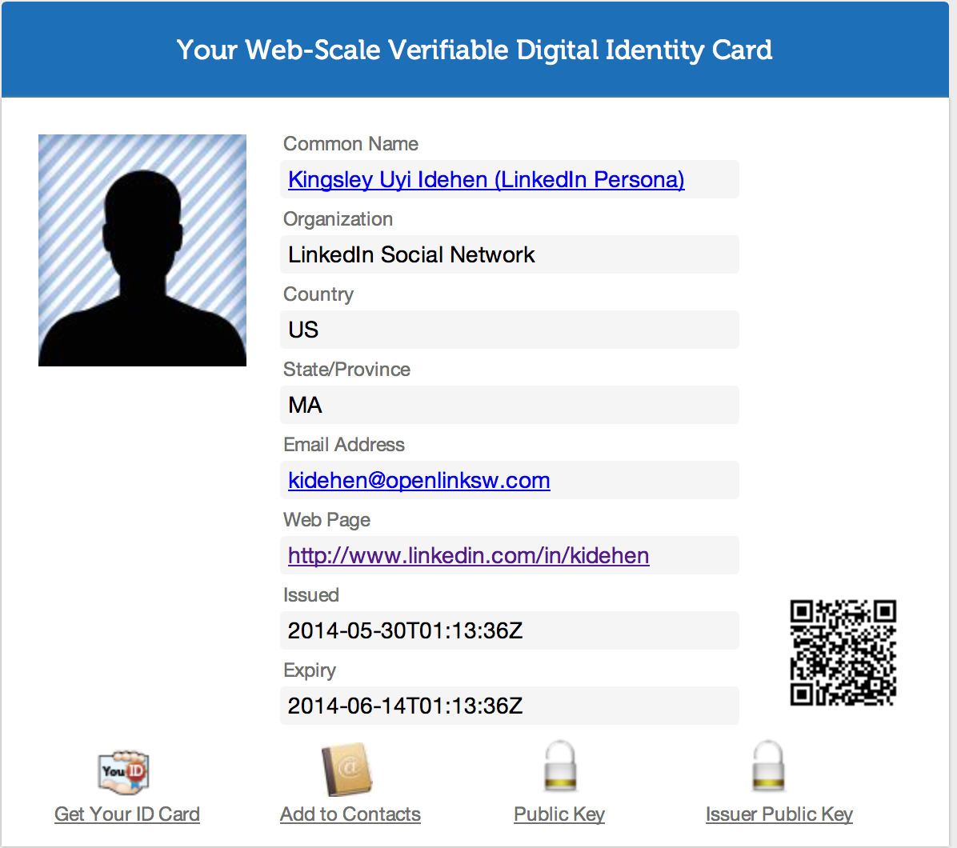
What is an Identity Card?
A Document comprised of content in the form of identity claims that coalesce around an identifier that names the Identity Card’s subject.
Basically, a document comprised of content that connotes (describes) its subject.

Slide 15
WebID-Profile Document -- Front
A Document comprised of RDF statement based identity claims that coalesce around an identifier that names the Identity Card’s subject.
Identity Card subject name MUST be in the form of an HTTP URI.

Slide 16
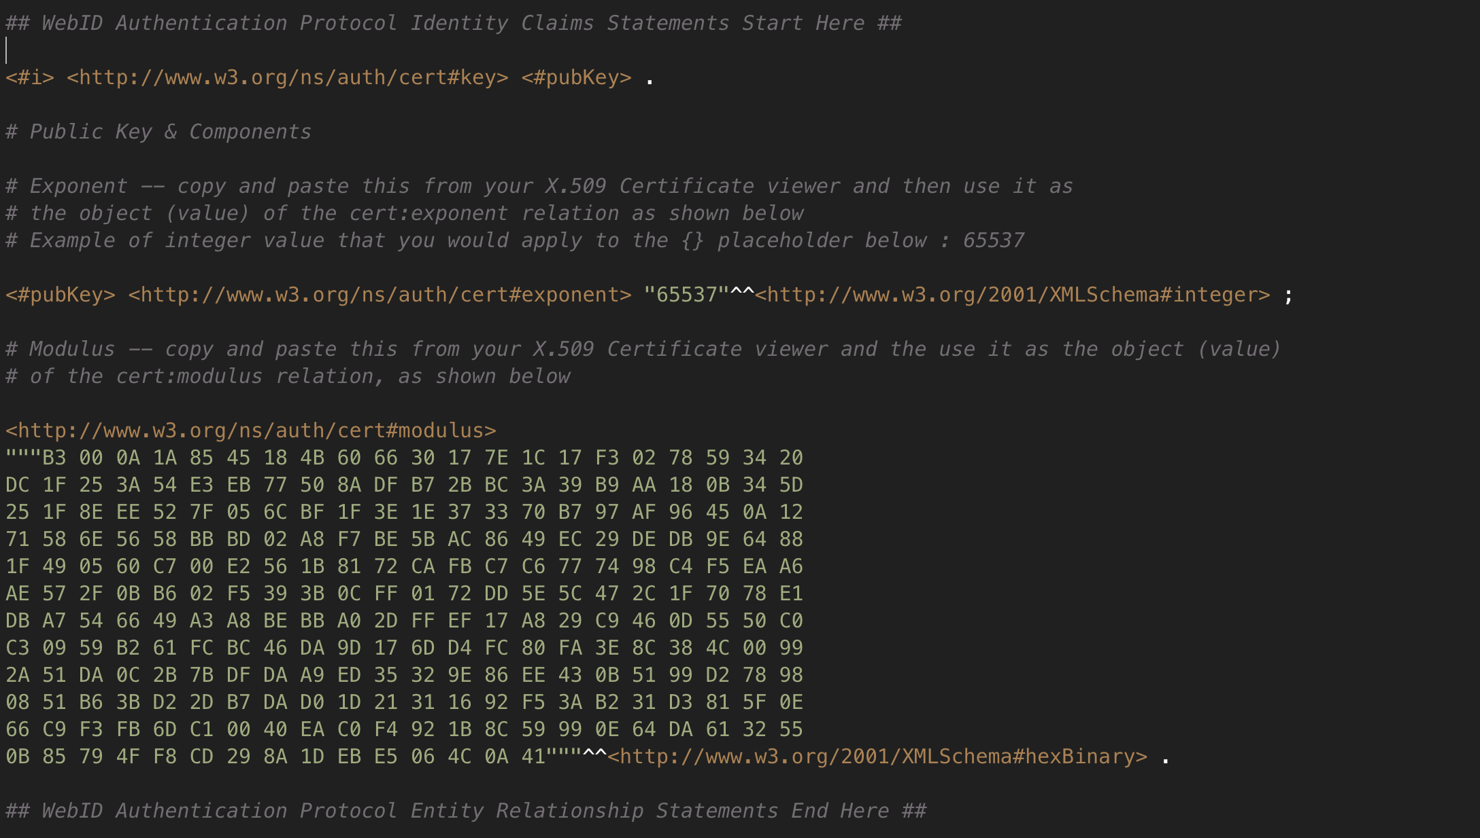
WebID-Profile Document -- Inside
A Document comprised of RDF statement based identity claims that coalesce around an identifier that names the Identity Card’s subject. Identity Card subject identifiers MUST be in the form of an HTTP URI.

Slide 17
NetID-Profile Document -- Front
A Document comprised of RDF statement based identity claims that coalesce around an identifier that names the Identity Card’s subject.
Identity Card subject identifiers MUST be in the form of Resolvable URIs, so LDAP scheme identifiers can apply.

Slide 18
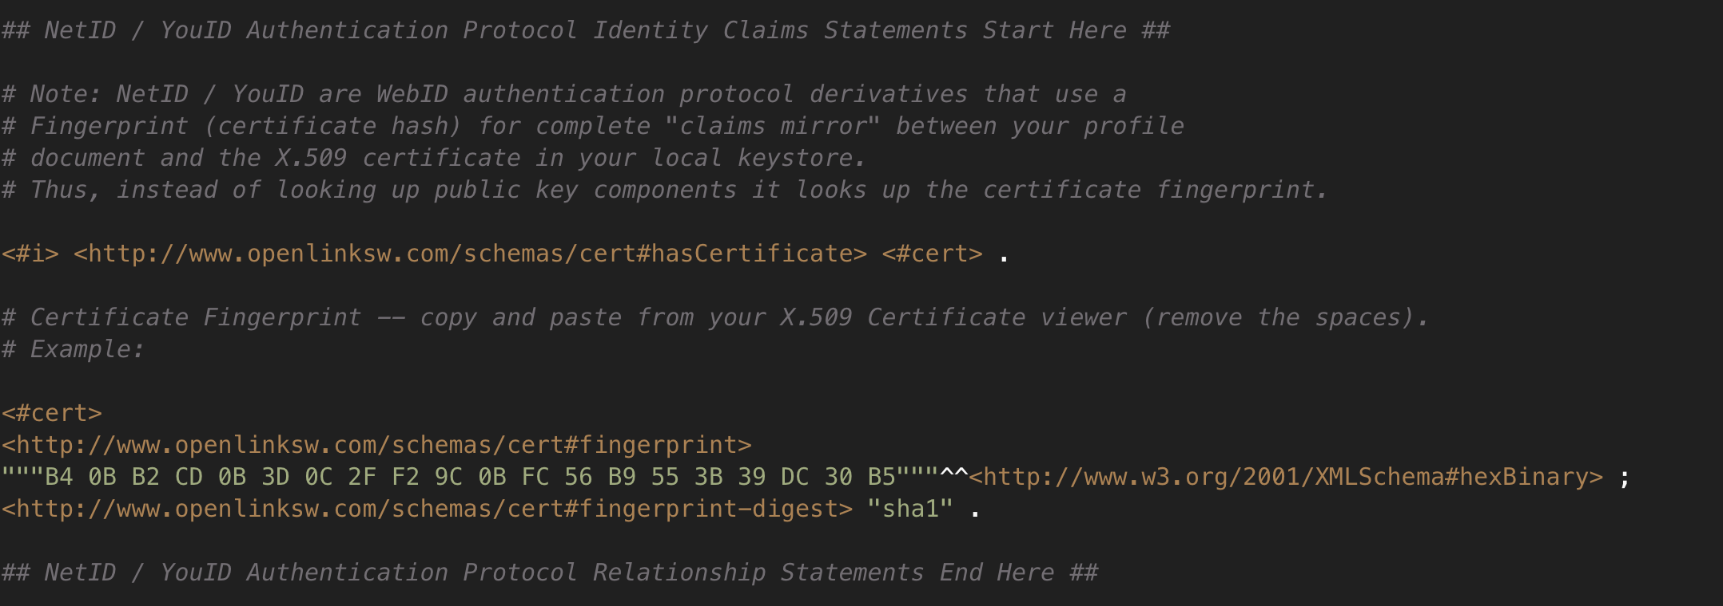
NetID-Profile Document -- Inside
A Document comprised of RDF statement based identity claims that coalesce around an identifier that names the Identity Card’s subject. Identity Card subject identifiers MUST be in the form of Resolvable URIs, so LDAP scheme identifiers can apply.

Slide 19
What Your Digital Identity Card Enables
Identification for 3rd Party Use – e.g., protected resource access controls and data access policies --scoped specifically to your identity
Signing Statements (Endorsements), Messages (e.g., Email) that are cryptographically verifiable
Receipt of Encrypted Messages that are only readable by you – since the entire message or shared-secret is encrypted using data (Public Key) from your Digital Identity Card
All of the items above using existing open standards.

Slide 20
Attributed Based Access Controls (ABAC)

Slide 21
What is ABAC About?
Fine-grained access to protected resources driven by attributes (characteristics, features, properties, predicates, relations etc.) of the resource requestor (an Identity Principal).
Notes:
Please check over colour keyed words
Deleted:
Words play Subject, Predicate, or Object roles in Sentences.

Slide 22
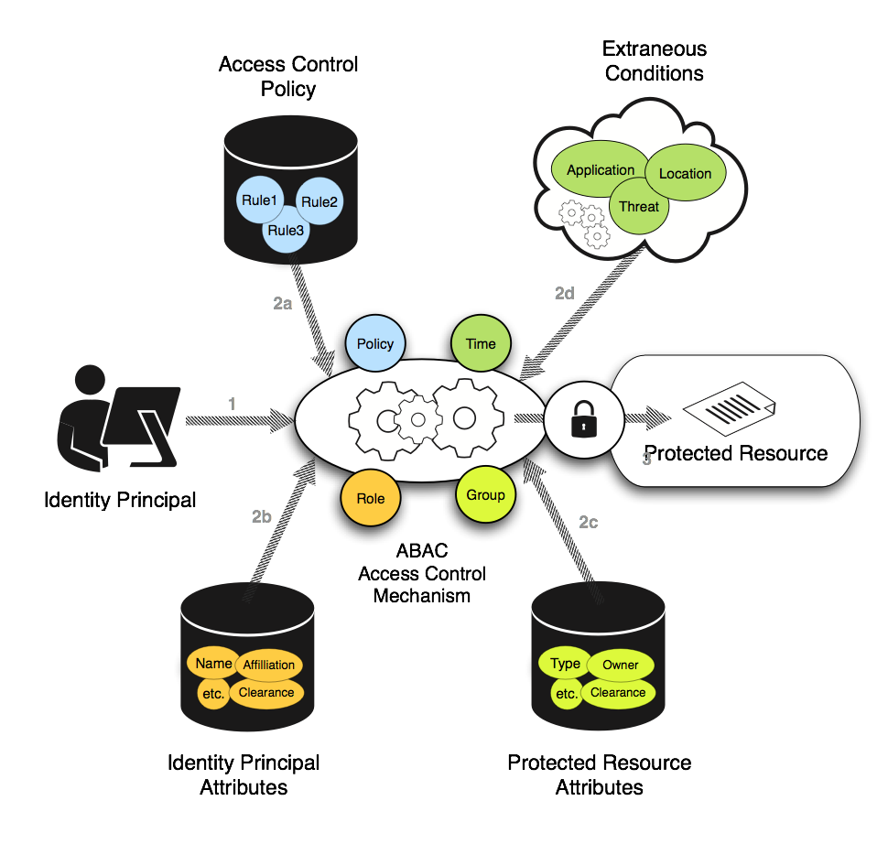
RDF based Attributed based Access Controls
Identity Principal Requests Access to Protected Resource
Protected Resource Server Assesses:
Identity (RDF based Identity Claims)
Access Control Rules (RDF based Protected Resource Access Policies)
Protected Resource Access is Granted or Rejected.

Slide 23
ABAC Challenges?
Identifier Types – NetID vs WebID Issues
Data Access Protocols – LDAP vs HTTP issues
Data Representation – Data Virtualization issues
Data Integration – RDF based Linked Open Data
Data Access Performance & Scalability – Virtuoso!
Notes:
Please check over colour keyed words
Deleted:
Words play Subject, Predicate, or Object roles in Sentences.

Slide 24
Identity Card Generation

Slide 25
WebID Identity Card Generation

Slide 26
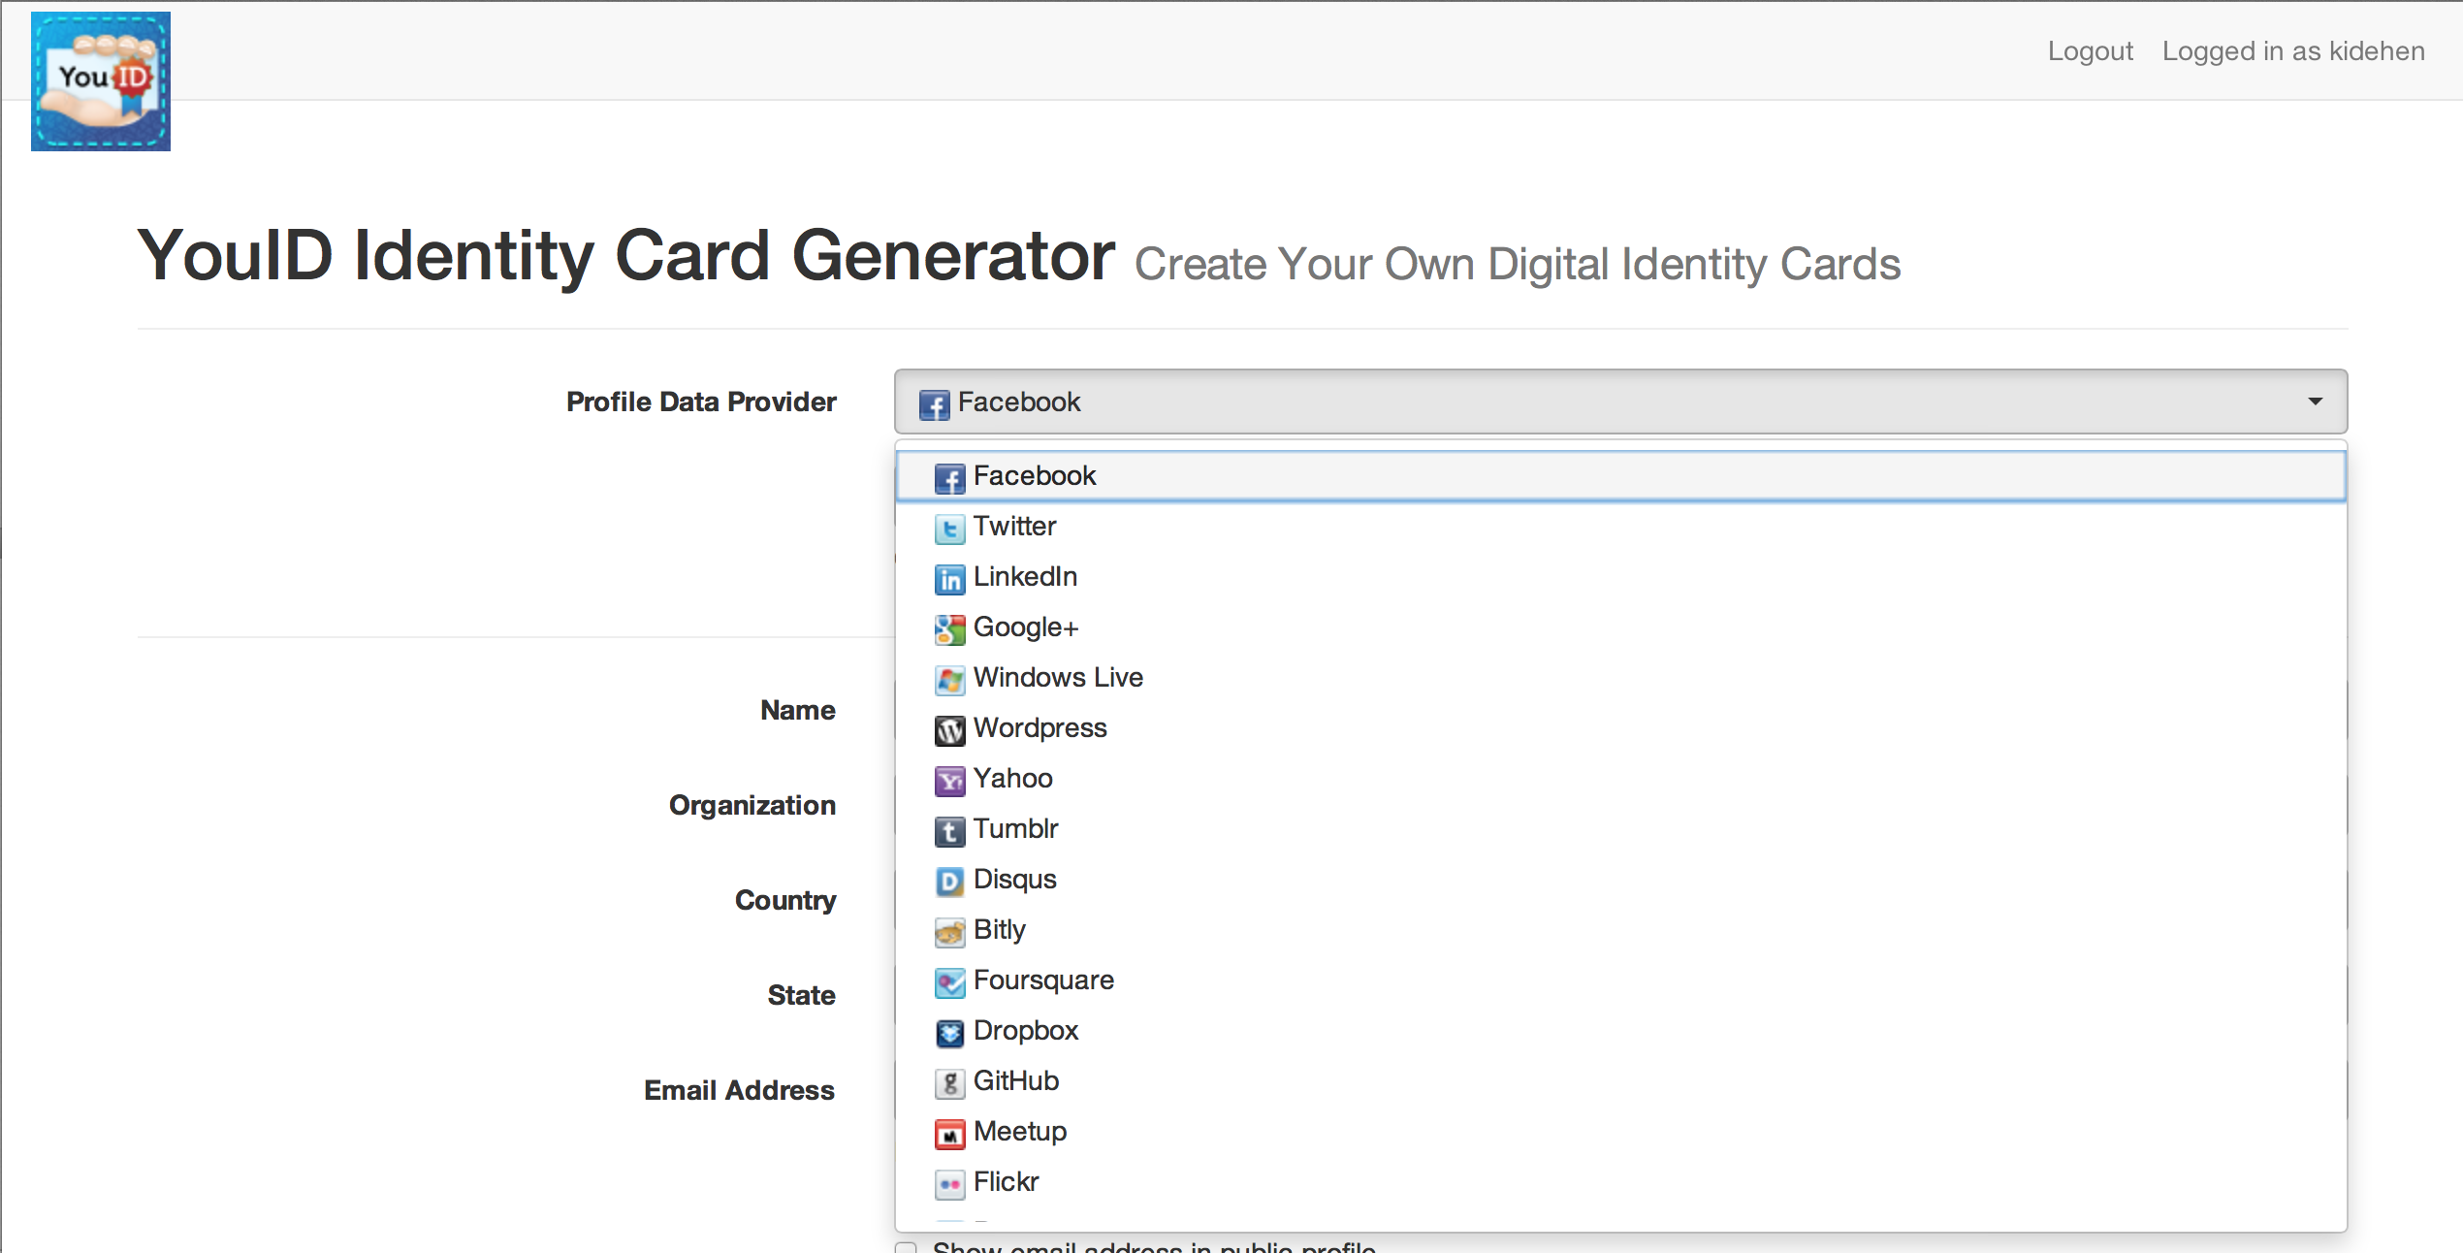
Digital Identity Card Generation – PdP Selection
Select from a vast collection of Profile Data Providers (PdPs)

Slide 27
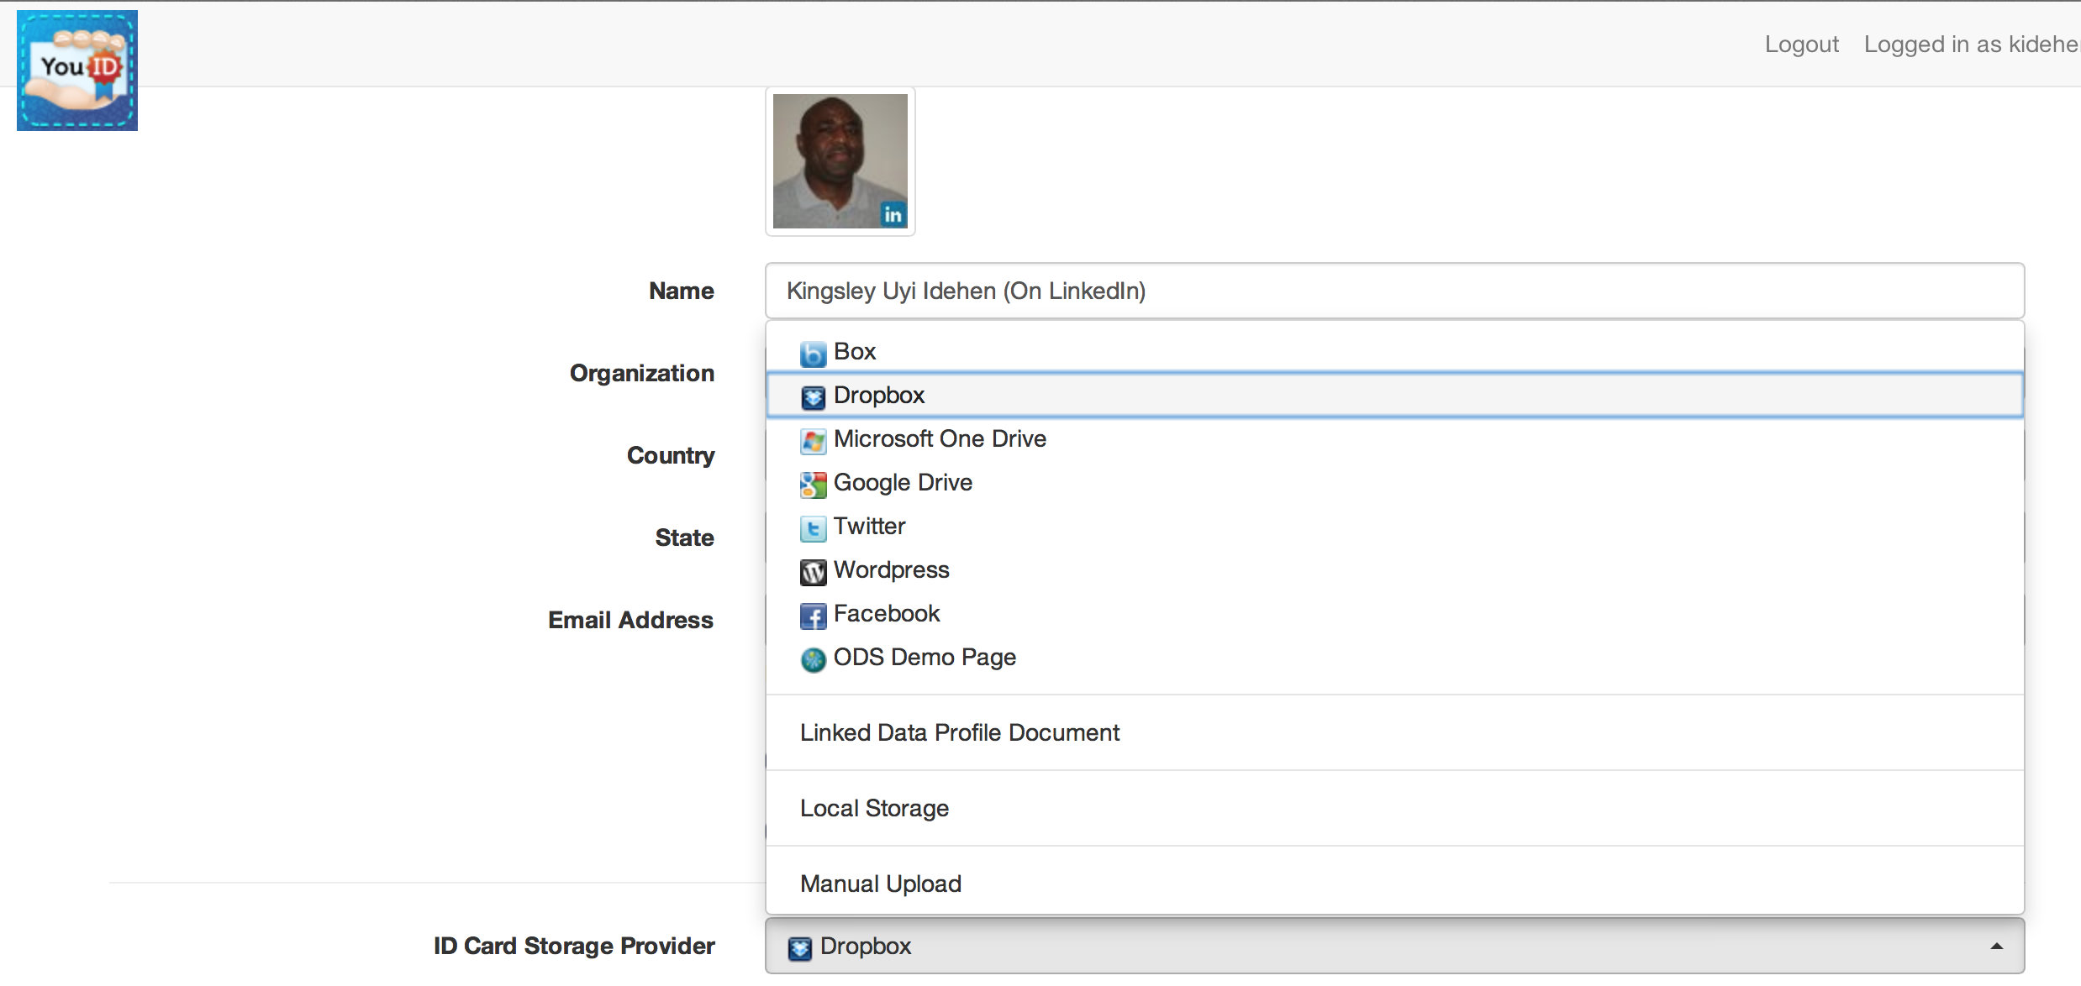
Digital Identity Card Generation – IdP Selection
Select from a vast collection of Identity Card Storage Providers (IdPs)

Slide 28
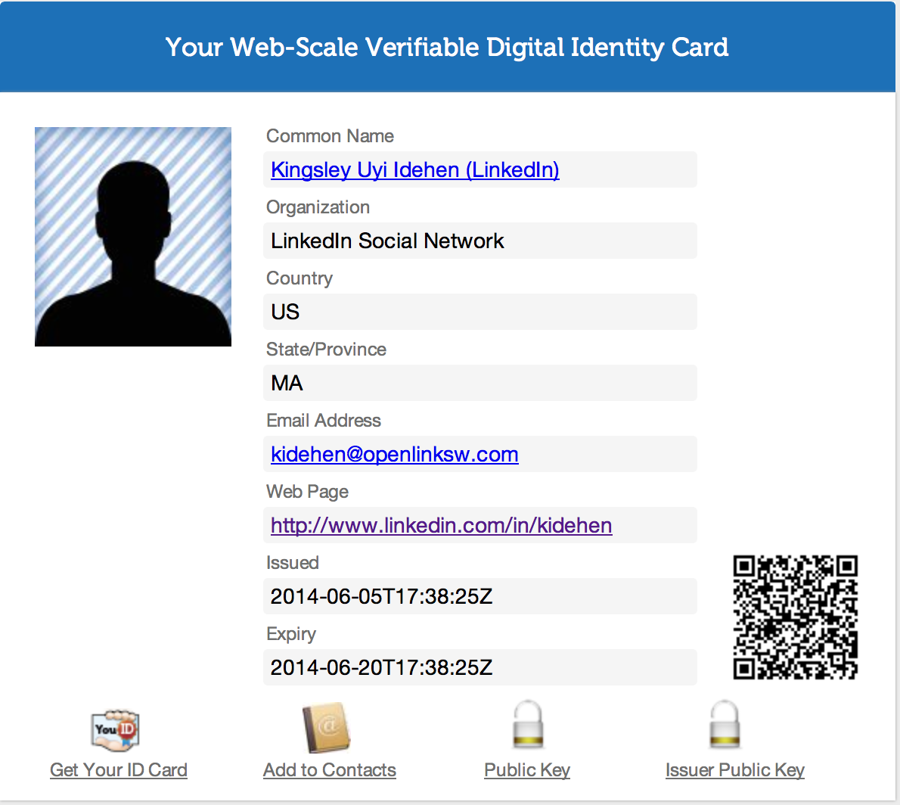
Generated Public Identity Card
A Document comprised of content in the form of identity claims that coalesce around an identifier (e.g., HTTP URI) that names the Identity Card’s subject.
Basically, a document comprised of content that connotes (describes) its subject.

Slide 29
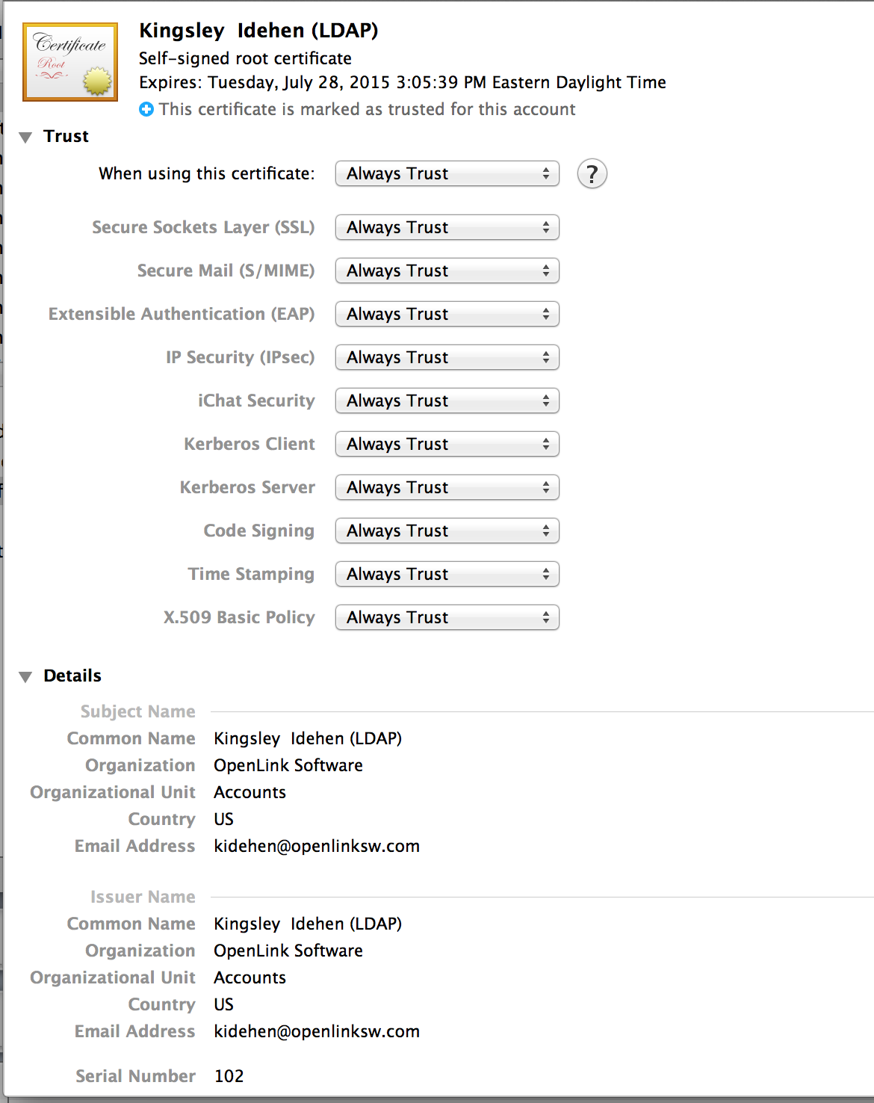
Local Identity Card (X.509 Cert.) View - 1

Slide 30
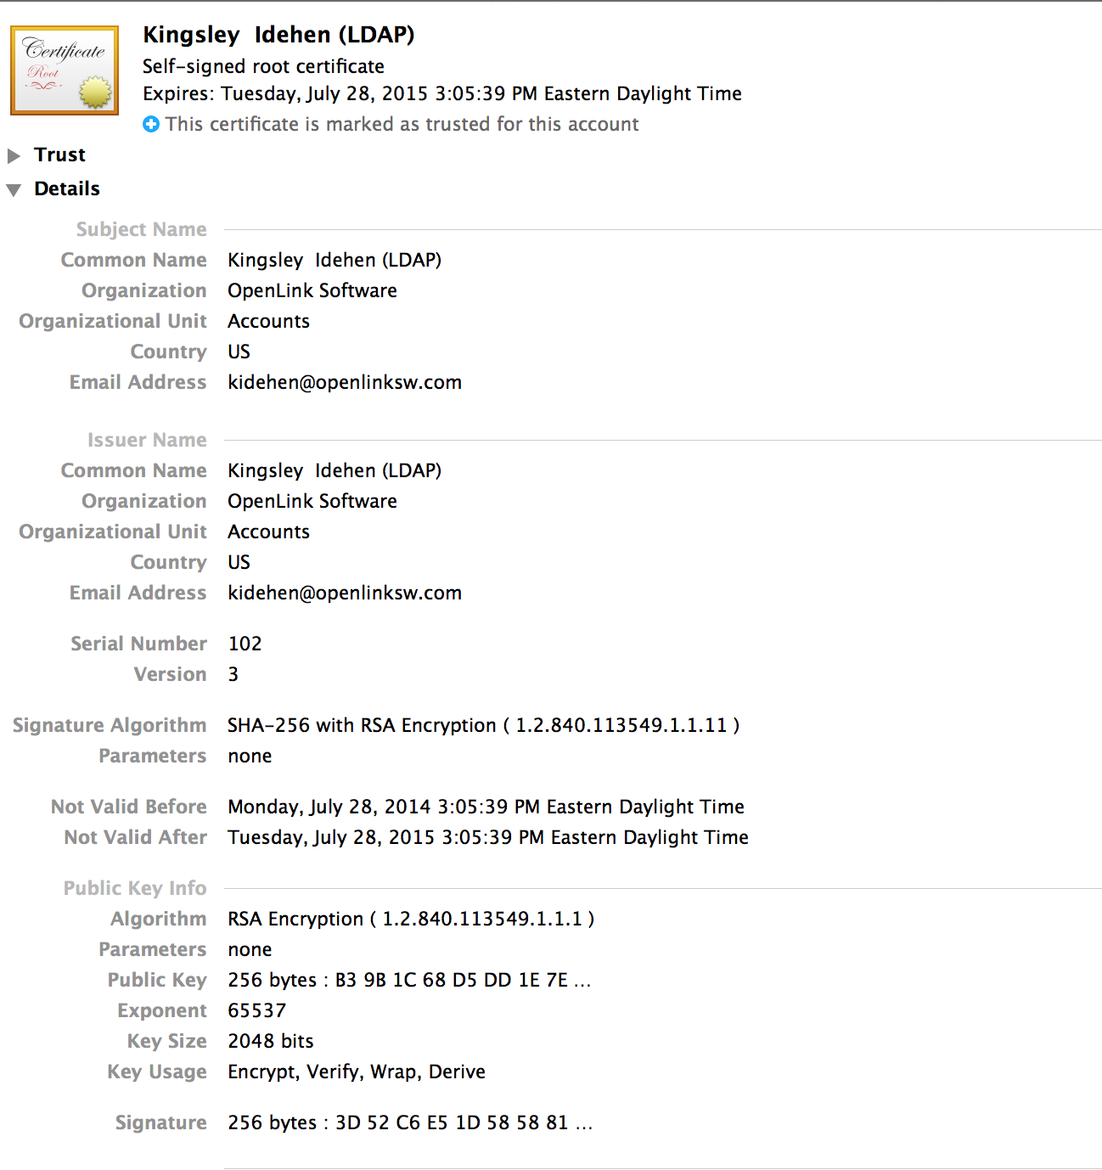
Local Identity Card (X.509 Cert.) View - 2

Slide 31
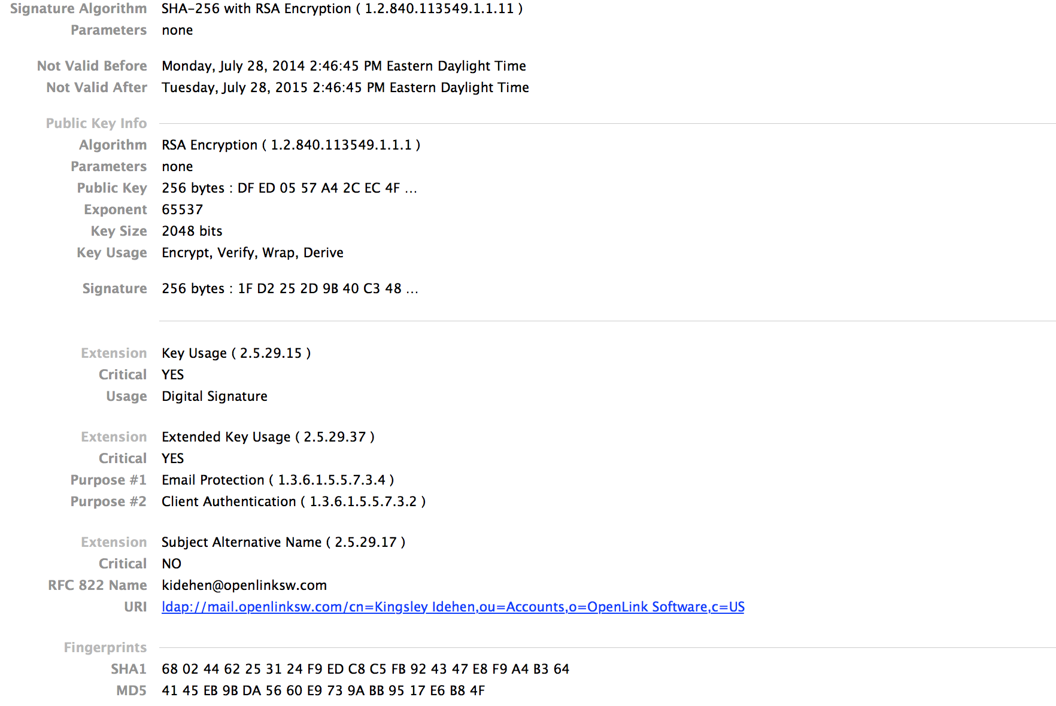
Local Identity Card (X.509 Cert.) View - 3

Slide 32
Authentication Protocols (WebID-TLS and NetID-TLS)

Slide 33
Critical Proof of Work
Fundamentally, NetID-TLS and WebID-TLS authentication protocols combine shared-secret knowledge (PKI) with proof-of-work. This includes:
Private & Public Keypair Possession
Private (X.509 Cert.) and Public (Profile Document) Identity Card Creation & Storage Capability
Ability to Express Entity Identity Claims using Entity Relationship Semantics that are comprehensible to both Humans and Machines.

Slide 34
What is WebID-TLS?
TLS based authentication protocol where identity claims are verified as follows:
User Agent initiates a TLS connection
Presents a locally stored Identity Card (X.509 Certificate) comprised of a WebID as its SubjectAlternativeName (SAN) value
Following successful TLS-handshake, a protected resource server performs these additional tests:
Checks that WebID successfully resolves to a profile document comprised of RDF statements
Checks existence of an RDF statement that associates WebID with the Public Key of the local X.509 certificate used to complete the successful TLS-handshake.

Slide 35
WebID-TLS Authentication Protocol Example

Slide 36
WebID-TLS Authentication – Step 1

Slide 37
WebID-TLS Authentication – Step 2

Slide 38
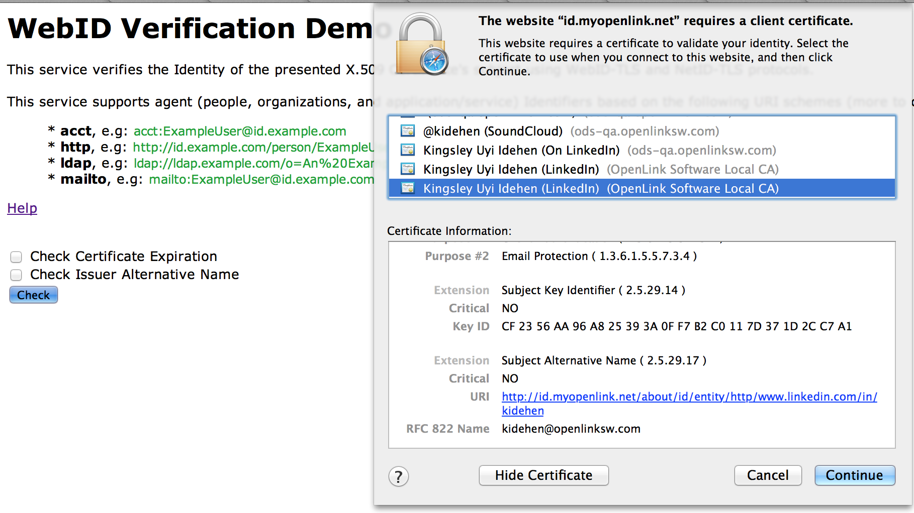
WebID-TLS Authentication – Step 3

Slide 39
WebID-TLS Authentication – Step 4

Slide 40
What is NetID-TLS?
TLS based authentication protocols where identity claims are verified as follows:
User Agent initiates a TLS connection
Presents a locally stored Identity Card (X.509 Certificate) comprised of a NetID as its SubjectAlternativeName (SAN) value
Following successful TLS-handshake, a protected resource server performs these additional tests:
Check that NetID is successfully resolved to a profile document
Checks that profile document is comprised of replica claims matching those in the local X.509 certificate – achieved by comparing the SHA1 fingerprints of both documents.

Slide 41
NetID Identity Card Generation

Slide 42
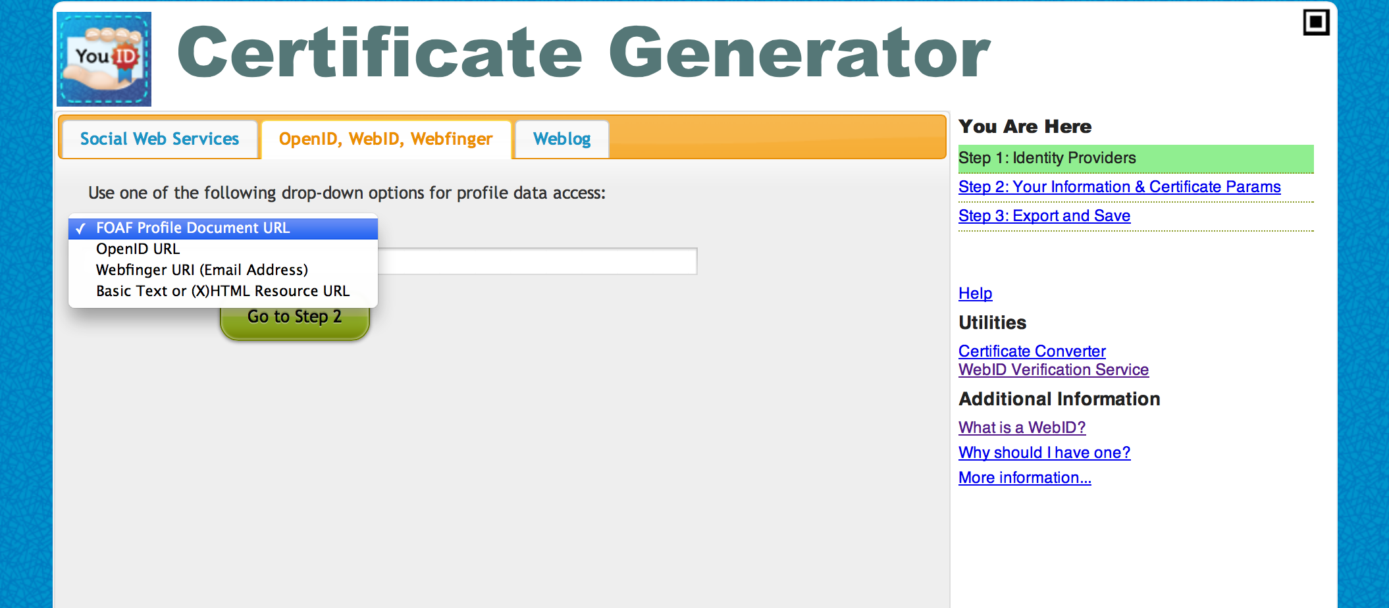
YouID Identity Card Creation – Step 1

Slide 43
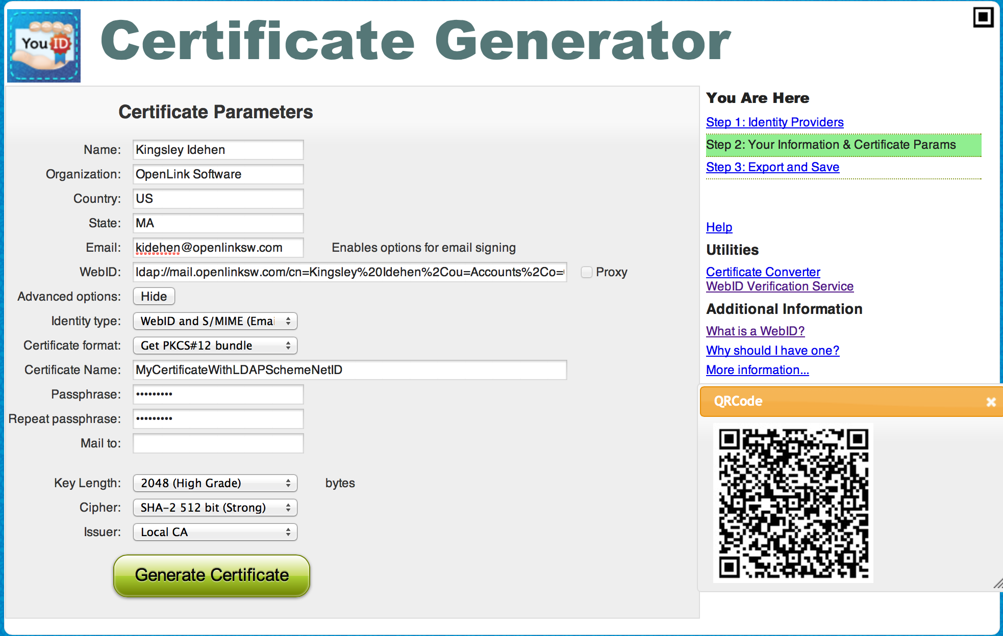
YouID Identity Card Creation – Step 2

Slide 44
Local Identity Card (X.509 Cert.) View - 1

Slide 45
Local Identity Card (X.509 Cert.) View - 2

Slide 46
Local Identity Card (X.509 Cert.) View - 3

Slide 47
NetID-TLS Authentication Protocol Example (LDAP Directory Services)

Slide 48
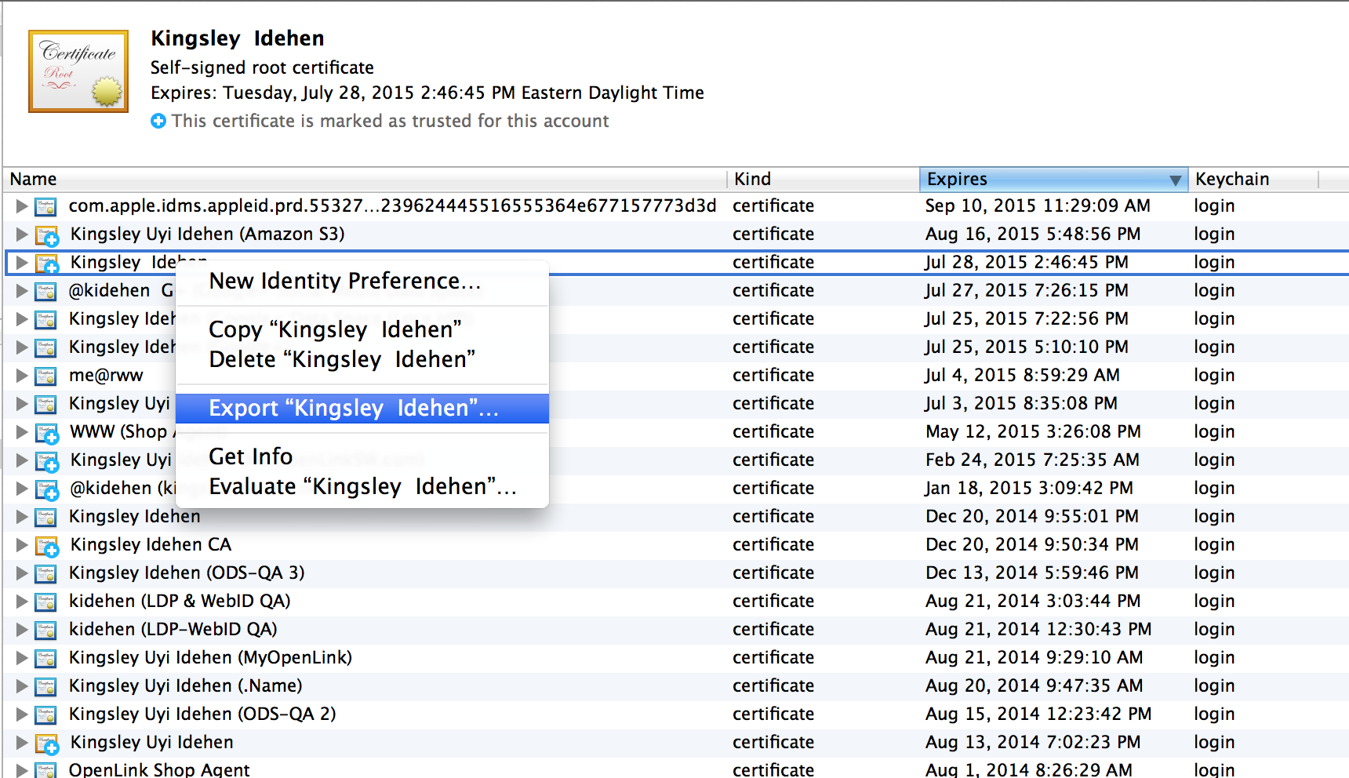
Identity Card Export for LDAP Directory Use

Slide 49
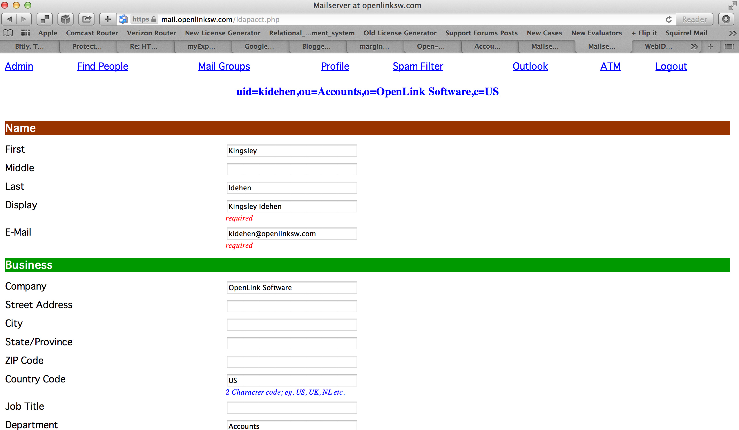
LDAP Directory Profile Edit Page

Slide 50
LDAP Directory Profile Edit – Certificate Binding
Associate certificate exported from keystore / keychain with LDAP Directory record

Slide 51
NetID-TLS Authentication (using an Identity Card with LDAP URI in it SAN)

Slide 52
NetID-TLS Authentication – Step 1

Slide 53
NetID-TLS Authentication – Step 2

Slide 54
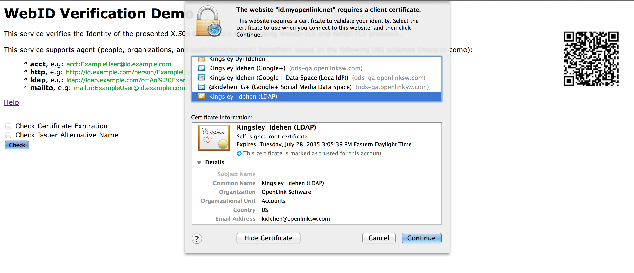
NetID-TLS Authentication – Step 3

Slide 55
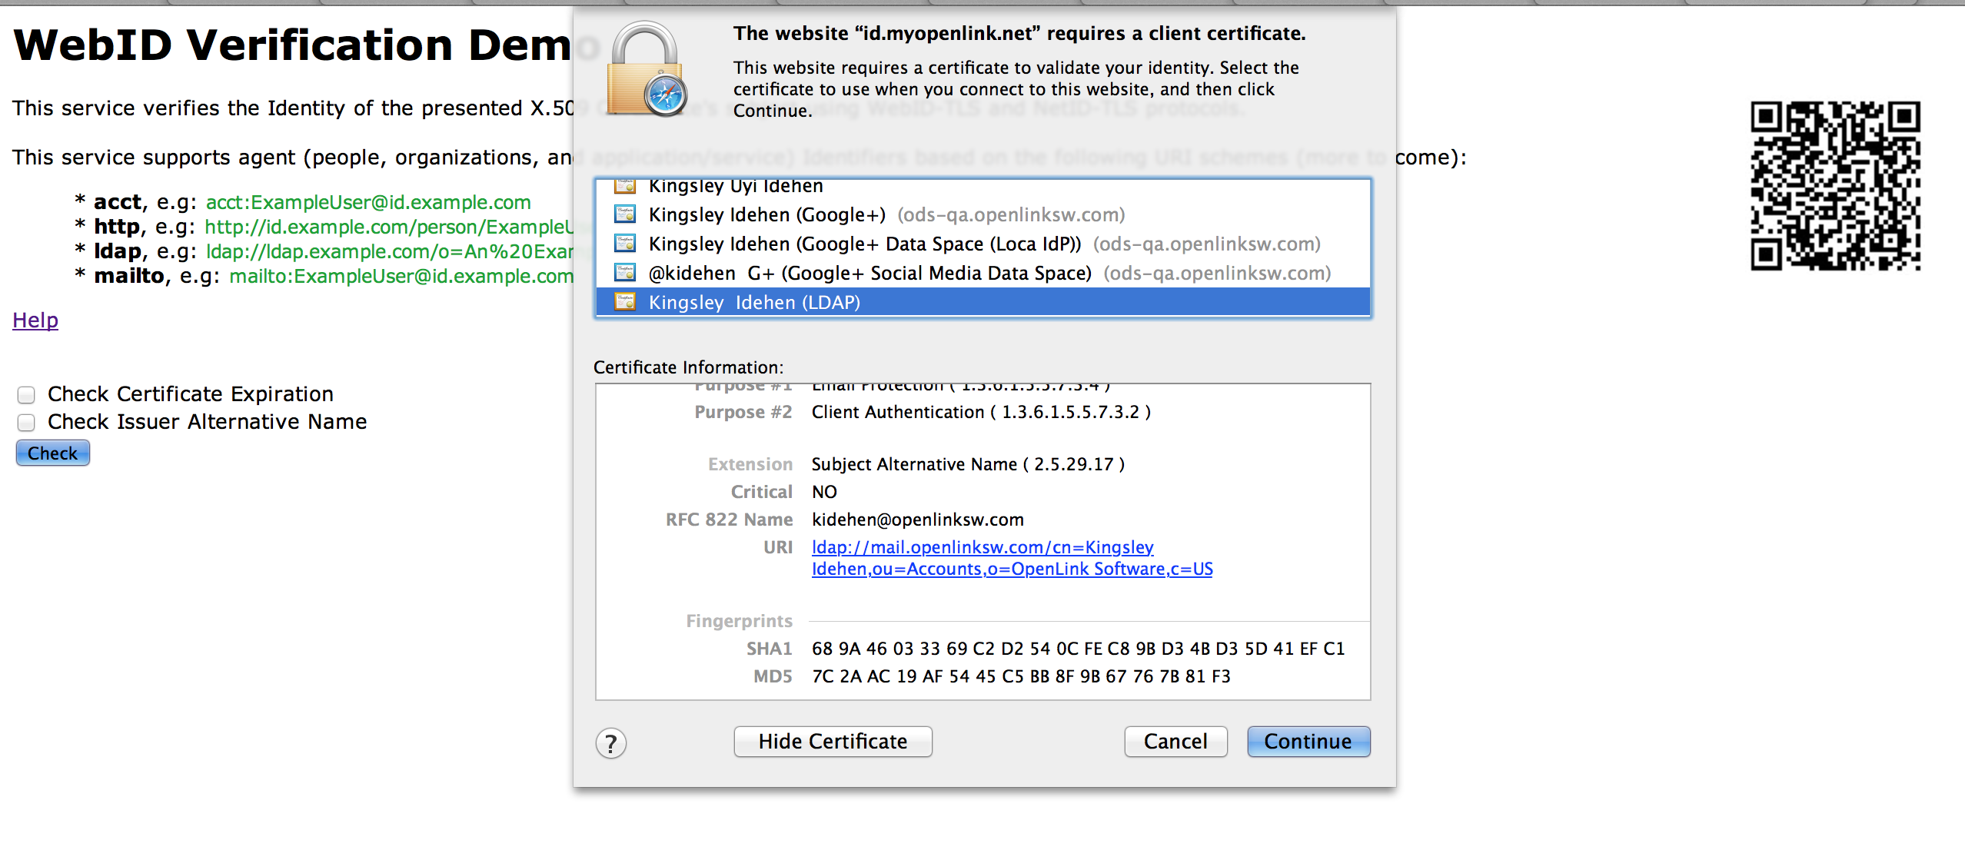
NetID-TLS Authentication – Step 4

Slide 56
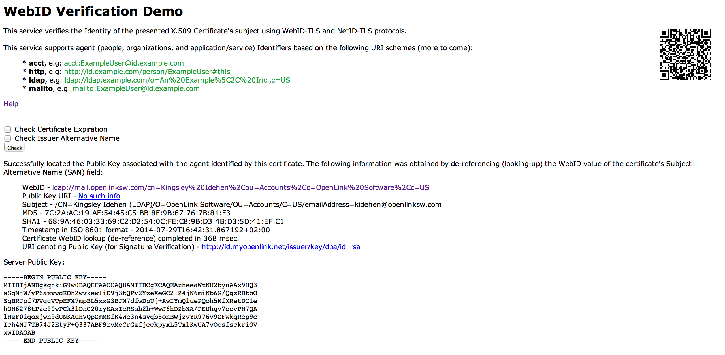
NetID-TLS Authentication – Step 5

Slide 57
Attributed Based Access Controls (ABAC) via NetID-TLS & WebID-TLS Authentication Protocols

Slide 58
Controlling Access to an HTTP-Accessible Document

Slide 59
Resource Protection – Step 1

Slide 60
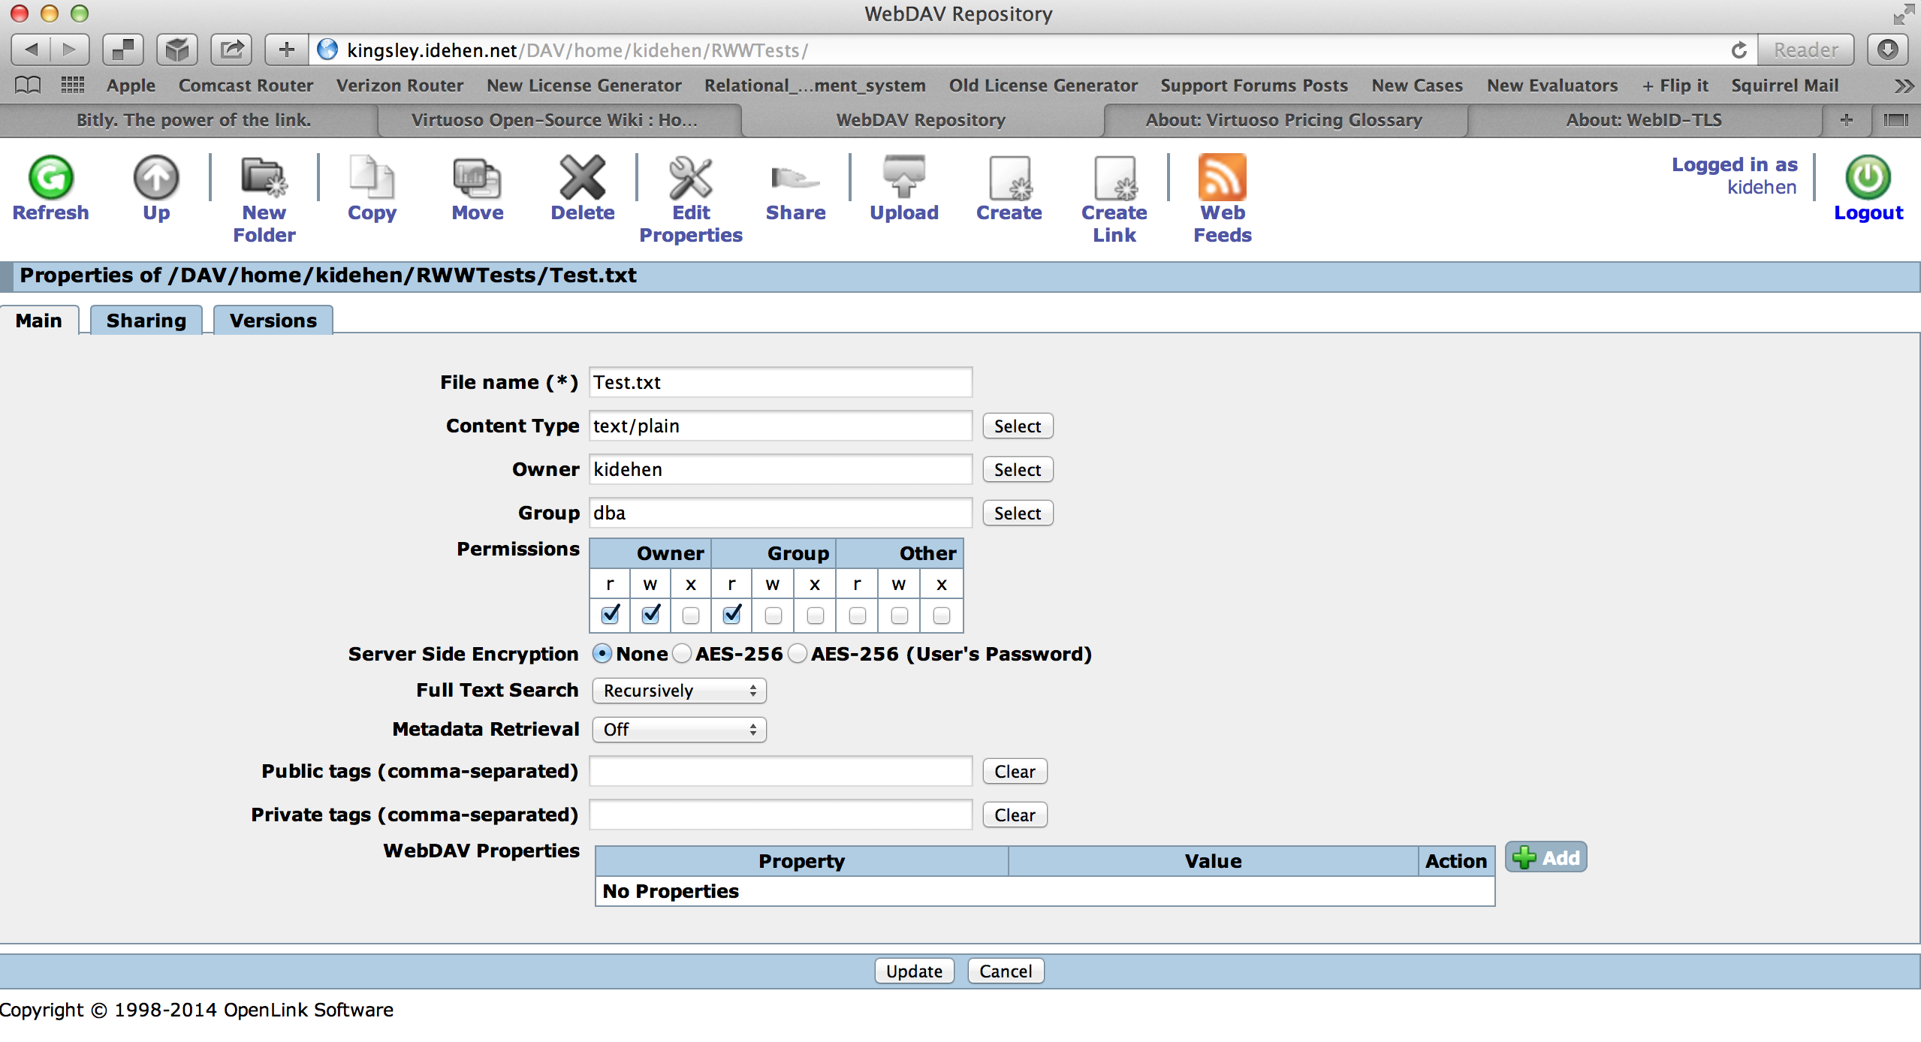
Resource Protection – Step 2

Slide 61
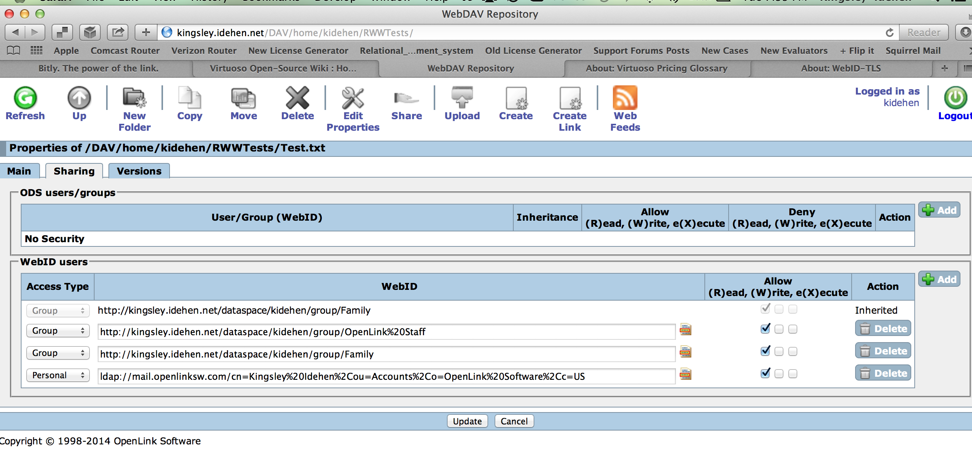
Resource Protection – Step 3

Slide 62
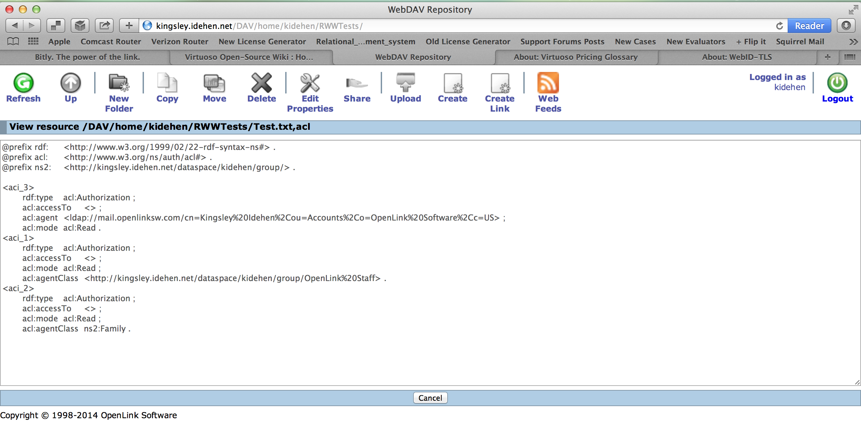
Actual Attribute Based Access Control

Slide 63
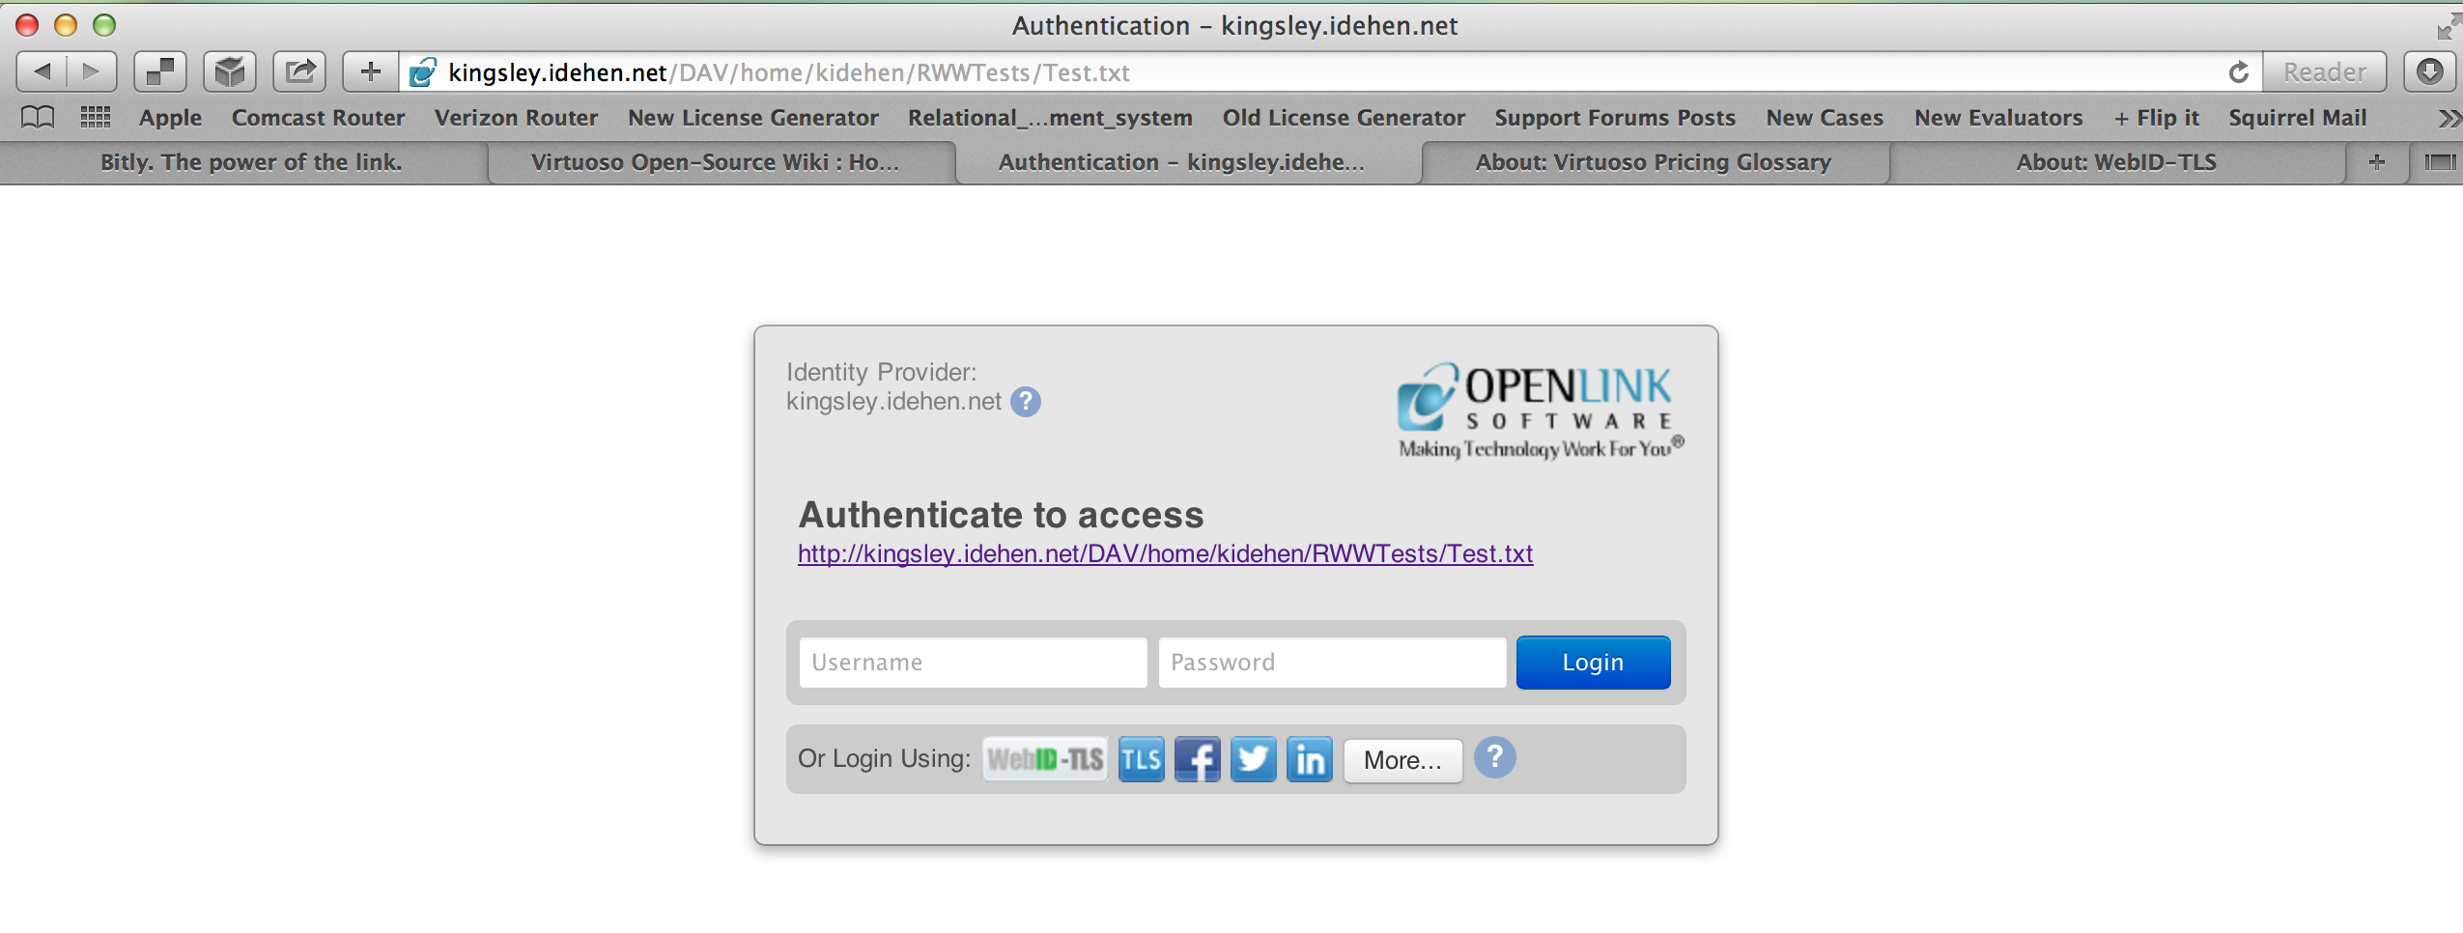
Protected Resource Access Challenge – Step 1

Slide 64
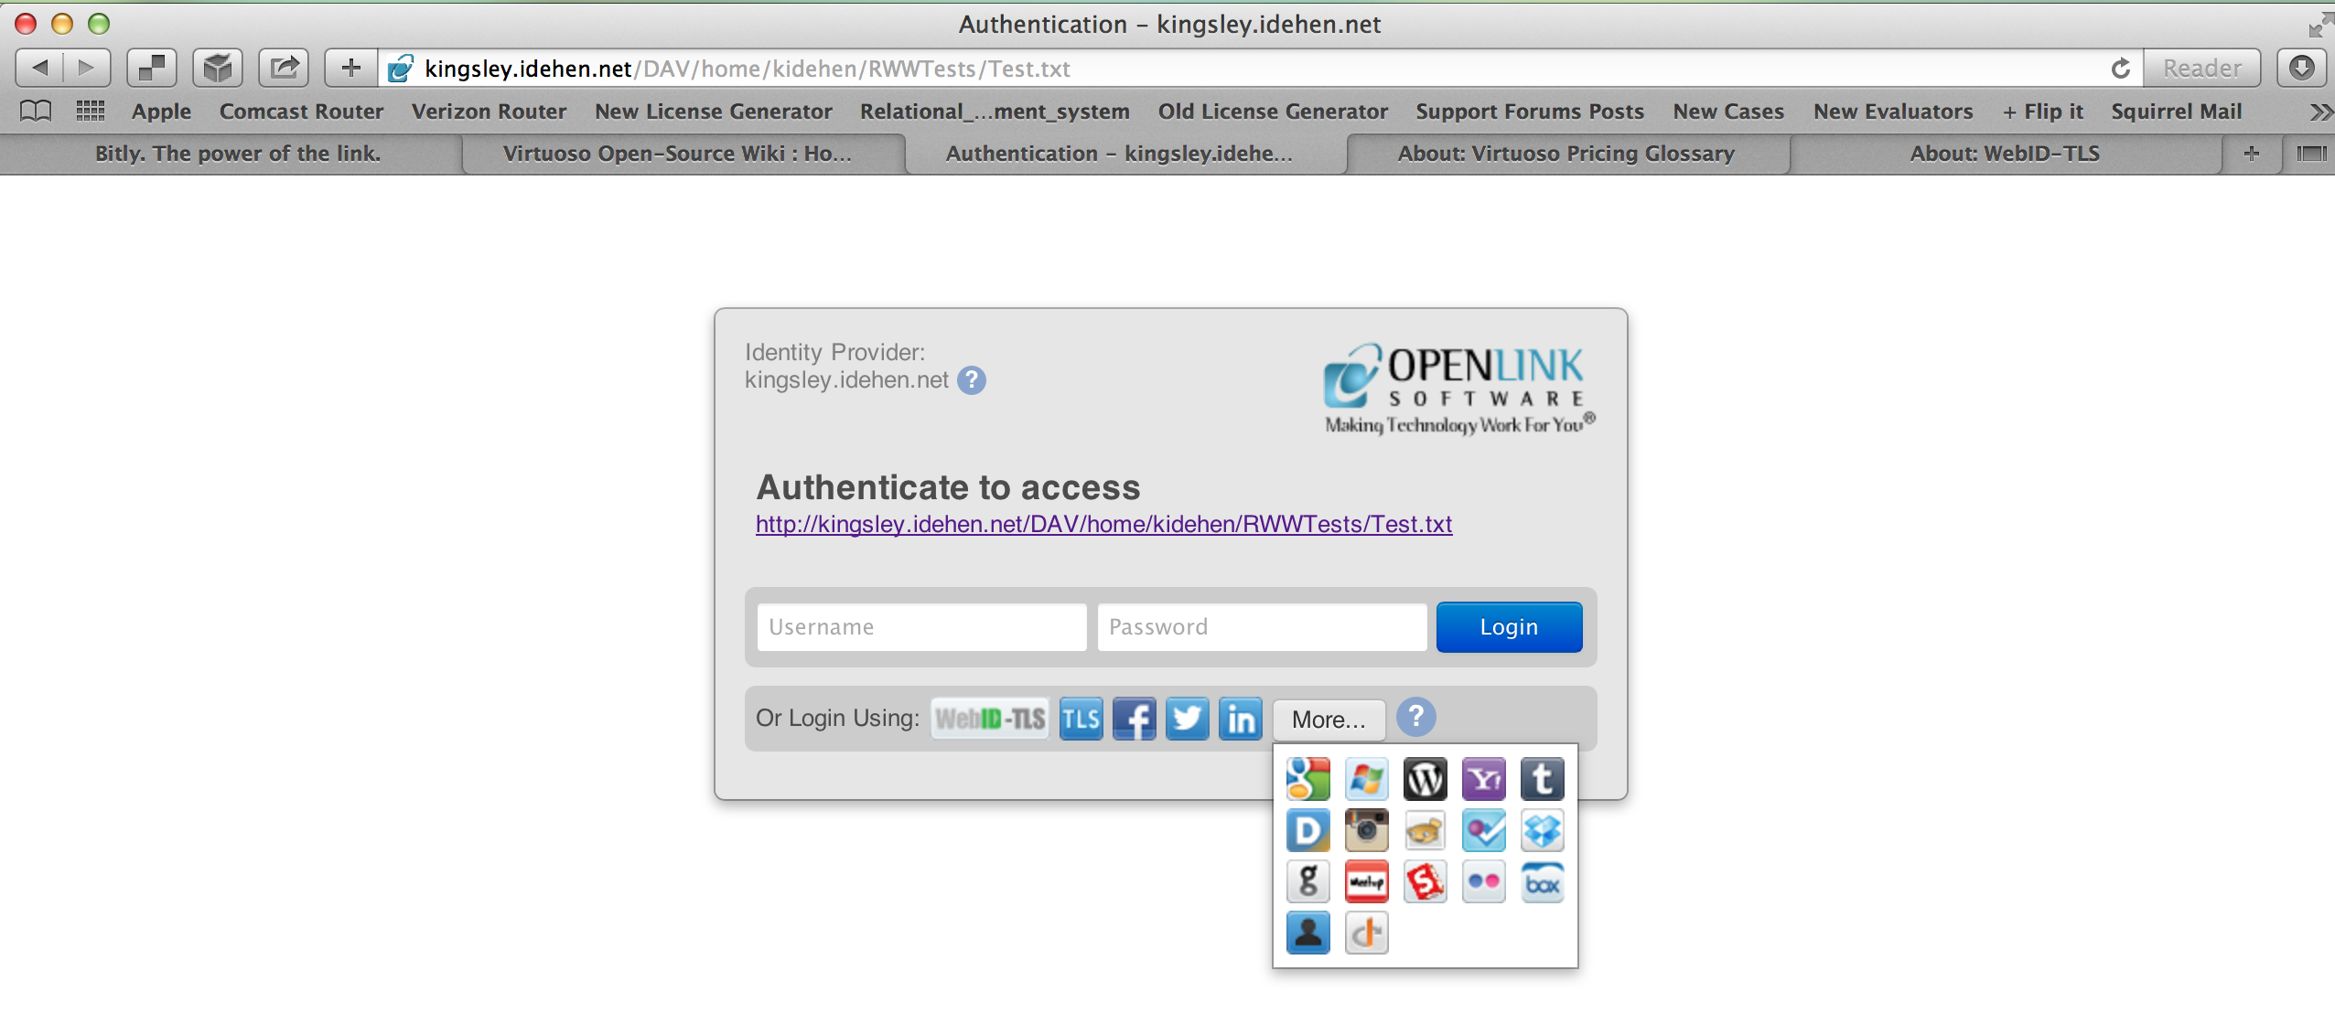
Protected Resource Access Challenge – Step 2

Slide 65
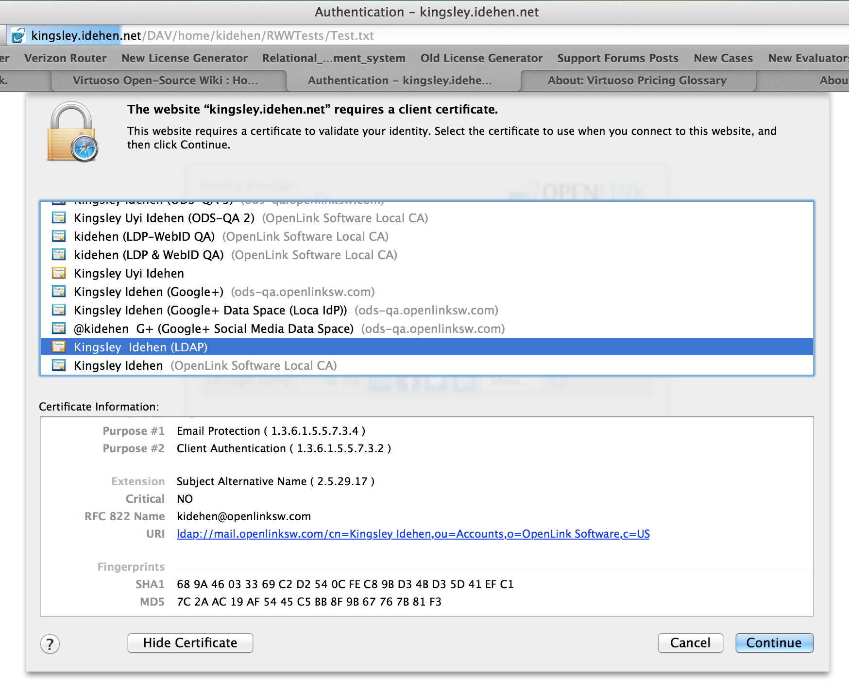
Protected Resource Access Challenge – Step 3

Slide 66
Protected Resource Access Challenge – Step 3

Slide 67
Controlling Access to a SPARQL Endpoint Example

Slide 68
RDF based ACL scoped to a Named Graph -- Template
## Protected (Private) Resource Authorization denoted by <{ACL-IRI}> ;
## created by the Identity Principal denoted by <{Rule-Creator-WEBID}> ;
## granting Read/Write privileges to the Named Graph denoted by <{Target-Named-GRAPH-IRI}> ;
## to identity principals denoted by the following <{GROUP-or-AGENT-IRI-1}>,
## <{GROUP-or-AGENT-IRI-N}>
PREFIX oplacl: <http://www.openlinksw.com/ontology/acl#>
PREFIX acl: <http://www.w3.org/ns/auth/acl#>
PREFIX foaf: <http://xmlns.com/foaf/0.1/>
<{ACL-IRI}>
a acl:Authorization ;
foaf:maker <http://kingsley.idehen.net/dataspace/person/kidehen#this> ;
oplacl:hasAccessMode oplacl:Write ;
acl:accessTo <urn:private:rdf:data:source> ;
acl:agent <ldap://mail.openlinksw.com/cn=Kingsley%20Idehen,ou=Accounts,o=OpenLink%20Software,c=US>, <http://id.myopenlink.net/dataspace/person/KingsleyUyiIdehen#this> ;
oplacl:hasScope oplacl:PrivateGraphs ;
oplacl:hasRealm oplacl:DefaultRealm .

Slide 69
Controlling Access to a SPARQL-accessible Named Graph

Slide 70
RDF based ACL scoped to a Named Graph -- Example
## Grant access to the Named Graph denoted by the IRI <urn:private:rdf:data:source>
## to identity principals denoted by the following IRIs
## <ldap://mail.openlinksw.com/cn=Kingsley%20Idehen,ou=Accounts,o=OpenLink%20Software,c=US>,
## <http://id.myopenlink.net/dataspace/person/KingsleyUyiIdehen#this>
PREFIX oplacl: <http://www.openlinksw.com/ontology/acl#>
PREFIX acl: <http://www.w3.org/ns/auth/acl#>
PREFIX foaf: <http://xmlns.com/foaf/0.1/>
<#AccessPolicy1>
a acl:Authorization ;
foaf:maker <http://kingsley.idehen.net/dataspace/person/kidehen#this> ;
oplacl:hasAccessMode oplacl:Write ;
acl:accessTo <urn:private:rdf:data:source> ;
acl:agent <ldap://mail.openlinksw.com/cn=Kingsley%20Idehen,ou=Accounts,o=OpenLink%20Software,c=US>, <http://id.myopenlink.net/dataspace/person/KingsleyUyiIdehen#this> ;
oplacl:hasScope oplacl:PrivateGraphs ;
oplacl:hasRealm oplacl:DefaultRealm .

Slide 71
Controlling Access to an HTTP (Web) Service

Slide 72
RDF based ACL scoped to a YouID Instance
PREFIX oplacl: <http://www.openlinksw.com/ontology/acl#>
PREFIX acl: <http://www.w3.org/ns/auth/acl#>
PREFIX foaf: <http://xmlns.com/foaf/0.1/>
<#YouIDUsagePolicy1>
a acl:Authorization ;
rdfs:comment ""”Machine-to-Machine ACL that controls access to an instance of the YouID
Identity Card Generator.""” ;
foaf:maker <{PERSON-WEBID}> ;
oplacl:hasAccessMode oplacl:Write ;
acl:accessTo <http://{HOST-CNAME}/youid> ;
acl:agent {Agent-WebID} ;
oplacl:hasScope <urn:virtuoso:val:scopes:youid> ;
oplacl:hasRealm oplacl:DefaultRealm .

Slide 73
Live Additional Information Links
An Glossary of terms, in Linked Data form:
WebID
WebID-TLS
NetID
NetID-TLS
Linked Data
Linked Open Data
Semantic Web
Resource Description Framework (RDF)

Slide 74
Additional Information
Web Sites
OpenLink Software
YouID – Digital Identity Card (Certificate) Generator
OpenLink Data Spaces – Semantically enhanced Personal & Enterprise Data Spaces & Collaboration Platform
OpenLink Virtuoso - Hybrid Data Management, Integration, Application, and Identity Server
Universal Data Access Drivers - High-Performance ODBC, JDBC, ADO.NET, and OLE-DB Drivers
LDAP and NetID-TLS – How to use LDAP scheme URIs with NetID-TLS Authentication
Social Media Data spaces
http://kidehen.blogspot.com (weblog)
http://www.openlinksw.com/blog/~kidehen/ (weblog)
https://plus.google.com/112399767740508618350/posts (Google+)
https://twitter.com/#!/kidehen (Twitter)
Hashtag: #LinkedData (Anywhere).

